Slide 1

Image Encryption & Decryption Web Application
Built Using Python Flask & AES-256 Encryption
Team Member:
Muhammad Tayyab Mujtaba Khan…..F24609035
Qasim Usman…………………………………….F24609008
Owais Ismail……………………………………..F24609055

Slide 2
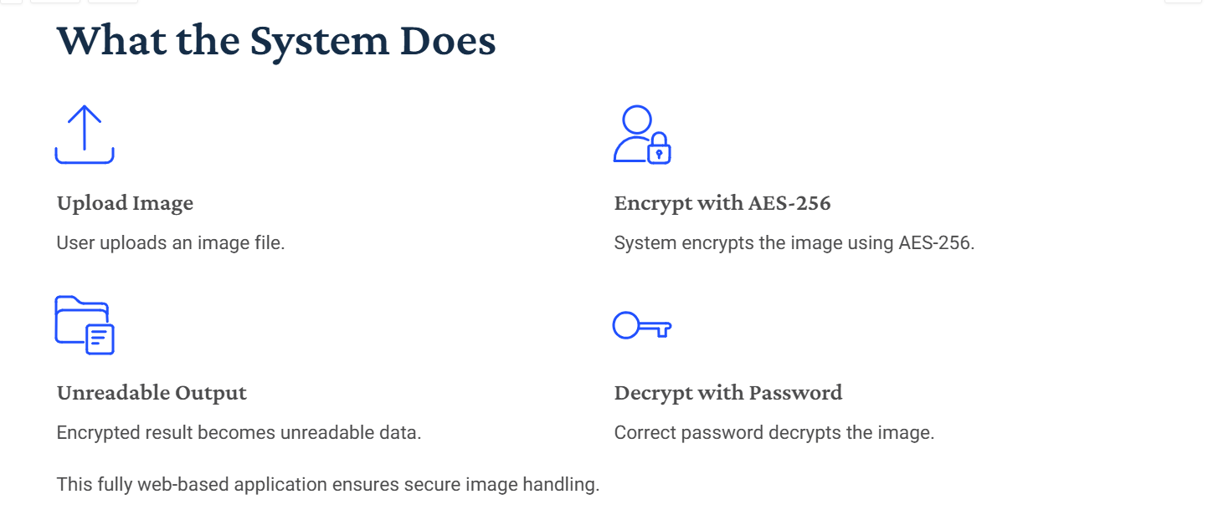

What the System Does
Upload Image
Encrypt with AES-256
User uploads an image file.
System encrypts the image using AES-256.
Unreadable Output
Decrypt with Password
Encrypted result becomes unreadable data.
Correct password decrypts the image.
This fully web-based application ensures secure image handling.

Slide 3

Why Web-Based? (Python Flask)
Built with Python Flask for backend logic.
Handles routing, image upload, encryption, and decryption.
Frontend uses HTML, CSS, and modern frameworks like Bootstrap/Tailwind.
Runs directly in your browser, no installation needed.
Offers fast, simple, and accessible image security.

Slide 4

What is AES-256?
Advanced Encryption Standard
AES is a symmetric encryption algorithm.
256-bit Key Strength
The "256" refers to the extremely strong 256-bit key length.
Industry Standard
Used by military, banks, and governments worldwide.
Brute Force Resistant
Highly resistant to all known forms of attack, including brute force.

Slide 5
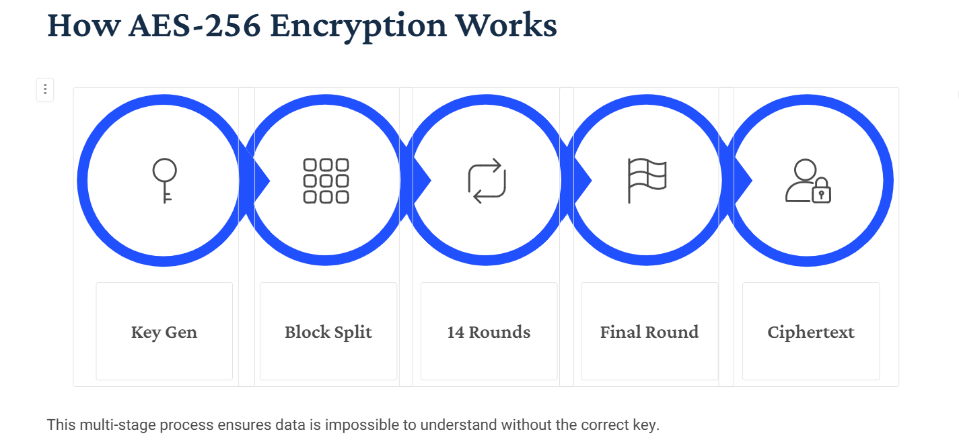
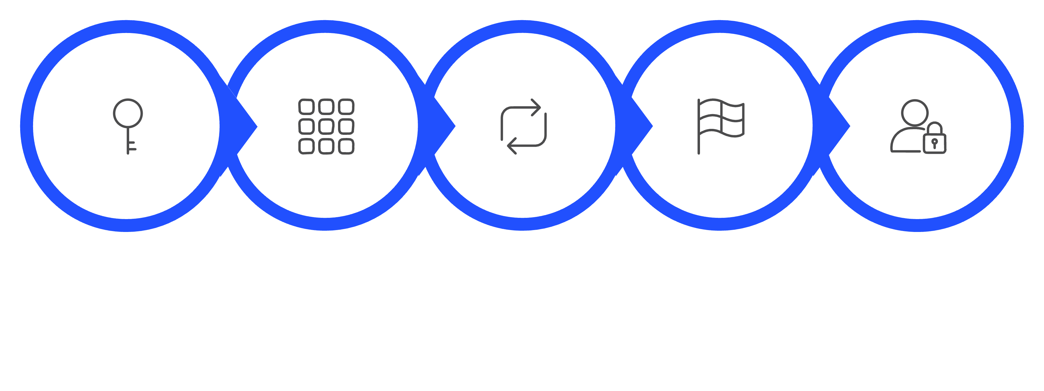
How AES-256 Encryption Works
Key Gen
Block Split
14 Rounds
Final Round
Ciphertext
This multi-stage process ensures data is impossible to understand without the correct key.

Slide 6
Encryption Process: Simple Steps
01
02
03
Upload Image
Enter Password
Key Generation
Select the image file to be secured.
Provide a strong password for encryption.
Password converts to AES-256 key.
04
05
Image Encryption
Download Encrypted File
AES encrypts image bytes into random data.
Receive the secure, unreadable file.

Slide 7

Why AES-256 Is So Secure
2²⁵⁶ Key Combinations: Makes brute-force attacks computationally impossible.
Strong Mathematical Structure: Designed to resist advanced cryptographic attacks.
Integrity Assurance: Using modes like AES-GCM ensures both encryption and data integrity.
Global Standard: Trusted and used worldwide for secure communication and data protection.

Slide 8





Decryption Overview
Upload Encrypted File
Select the secured image file.
Enter Password
Provide the original password.
Key Regeneration
System regenerates the key using PBKDF2.
AES Decryption
Data is decrypted block-by-block.
Image Restored
The original image is recovered. Incorrect password will fail decryption.

Slide 9

The Critical Role of Your Password
Key Determinant: Your password directly generates the encryption key.
Security Strength: A weak password compromises even military-grade encryption.
Military-Grade Protection: A strong password ensures robust security.
Irreversible Without Key: Encryption cannot be undone without the exact password.

Slide 10
Final Summary: Secure Image Handling
Web-Based App
AES-256 Strong Encryption
Secure Image Operations
Built with Flask & Python for accessibility.
Utilizes industry-standard, robust security.
Encrypts and decrypts images reliably.
User-Friendly Interface
Powerful Combination
Modern design for ease of use.
Cryptography meets web tech for ultimate security.

Slide 11
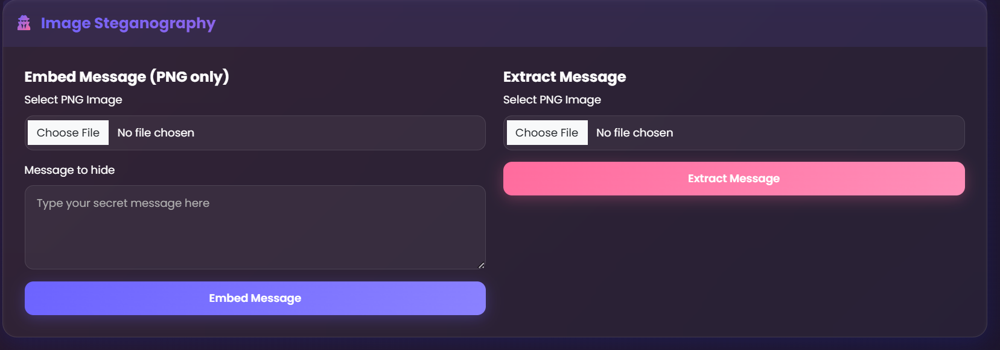
Steganography Module
Additional feature included in the project.
Uses Image Steganography to hide secret text in images.
Output looks the same but contains hidden data.
This enhances confidentiality alongside AES encryption.

